Slide 1
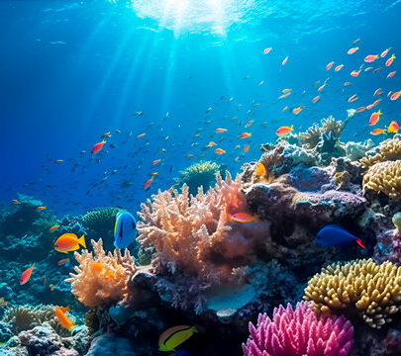
Underwater Image Enhancement
Project By : -
Deb Mukherjee (121EC0289) (Team Lead)
Debashis Satpathy (121EC0300)
Rishabh Singh (121EC0305)

Slide 2
Objective and Motivation
Underwater images are a good source of information about sea creatures , seafloor hydrothermal vents , shipwrecks , etc.
Underwater images have poor visibility due to absorption and scattering of light resulting in images with low contrast and colour distortion.
With this project , we hope to improve the quality of underwater images for further research / machine learning purposes

Slide 3
Requirements
SOFTWARE
Python language
Python libraries like matplotlib, NumPy , PIL , scikit-image , etc.
Image dataset taken from https://www.kaggle.com/datasets/ashish2001/semantic-segmentation-of-underwater-imagery-suim?select=TEST

Slide 4
MODEL Underwater Image Enhancement via Adaptive color correction and stationary wavelet details enhancement
In this model we hope to work on the RGB channels separately and perform colour corrections to each separately , mainly due to the difference in wavelengths and scattering of different colours.
Then we perform stationary wavelet transform to enhance image details like denoising , edge detection , feature detection , etc.
Then , we combine the RGB colour channels and perform contrast limited adaptive histogram equalization(CLAHE) to improve the contrast of the image.

Slide 5
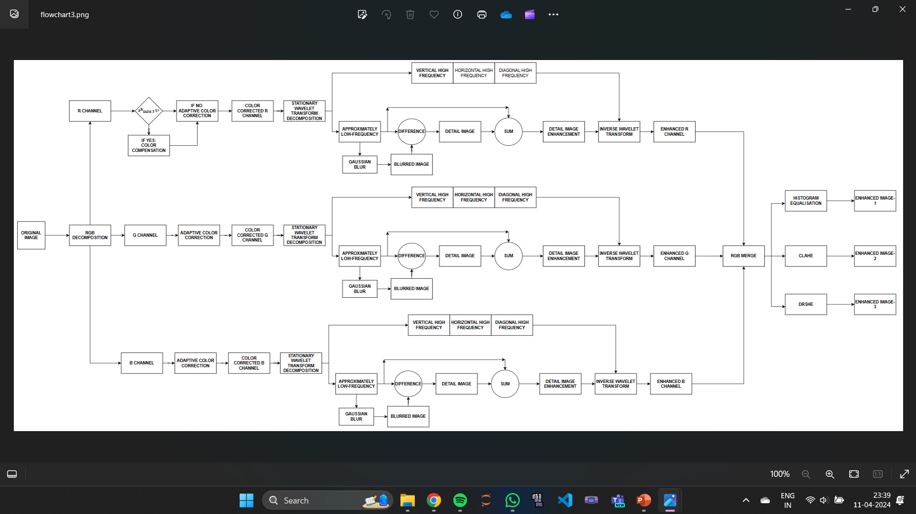

Slide 6
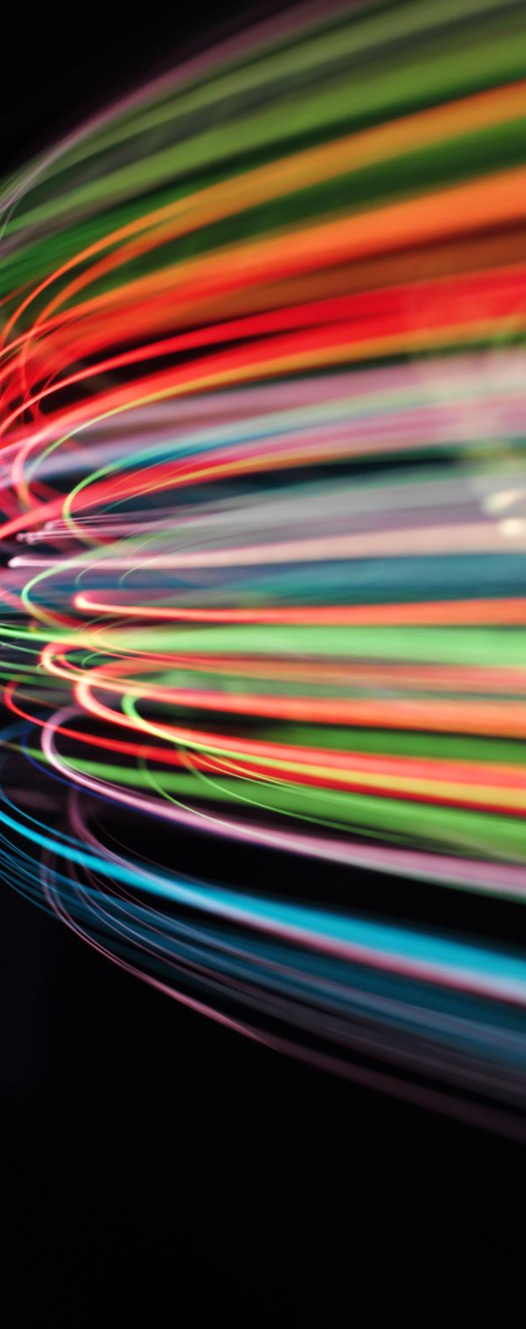
RGB Channels Decomposition
Due to its longer wavelength , red light is easily absorbed by water unlike blue-green light with shorter wavelength which have a stronger propagation capacity.
So , underwater, red light diminishes rapidly and blue-green light maintain a stronger intensity than red light.
Therefore , we need to perform colour correction to the different channels separately for better overall enhancement.

Slide 7
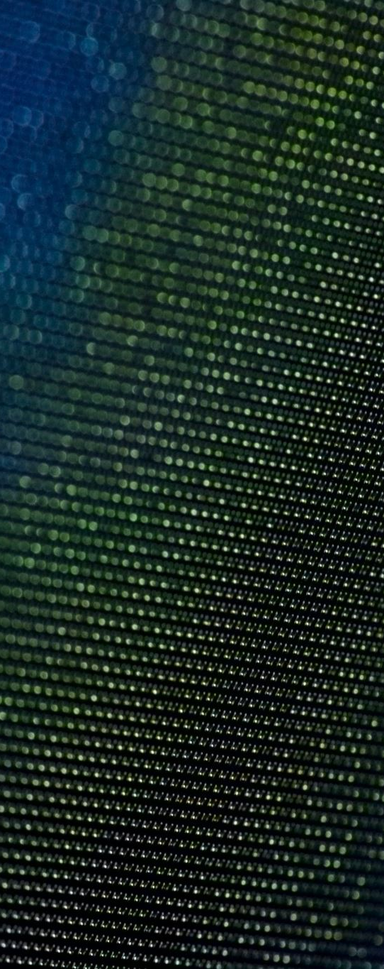
RGB Channels Decomposition
In python , we can separate an image into RGB channels using the split() function of the cv2 library , or by converting image into a NumPy array.
blue_channel, green_channel, red_channel = cv2.split(image)
red_channel = numpy.array(image)[:,:,0]
green_channel = numpy.array(image)[:,:,1]
blue_channel = numpy.array(image)[:,:,2]

Slide 8
Adaptive Colour Correction
Traditional image processing techniques use correction methods based on colour statistics which are simple and efficient but depend on a constant fixed parameter λ to control the dynamic range of the image.
This constant λ does not account for the varying colour distributions in different underwater images.
To account for this , we use λ , along with the mean and variance for each colour channel and the similarity value of each channel to design a new adaptive normalization range to better control the dynamic range of the image.

Slide 9
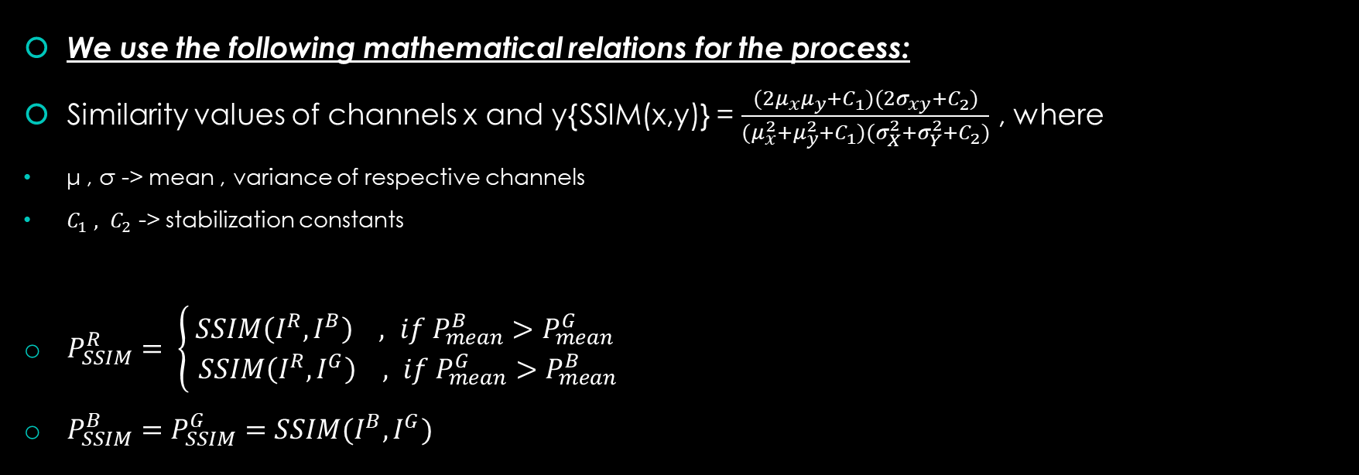
Adaptive Colour Correction
We use the following mathematical relations for the process:
Similarity values of channels x and y{SSIM(x,y)} = $\frac{(2μ_{x}μ_{y}+C_{1})(2σ_{xy}+C_{2})}{(μ_{x}^{2}+μ_{y}^{2}+C_{1})(σ_{X}^{2}+σ_{Y}^{2}+C_{2})}$ , where
μ , σ -> mean , variance of respective channels
$C_{1} , C_{2}$ -> stabilization constants
$P_{SSIM}^{R}= \left\{ \begin{aligned}SSIM\left(I^{R},I^{B}\right) , if P_{mean}^{B}>P_{mean}^{G} \\ SSIM\left(I^{R},I^{G}\right) , if P_{mean}^{G}>P_{mean}^{B}\end{aligned}\right.$
$P_{SSIM}^{B}=P_{SSIM}^{G}=SSIM(I^{B},I^{G})$

Slide 10
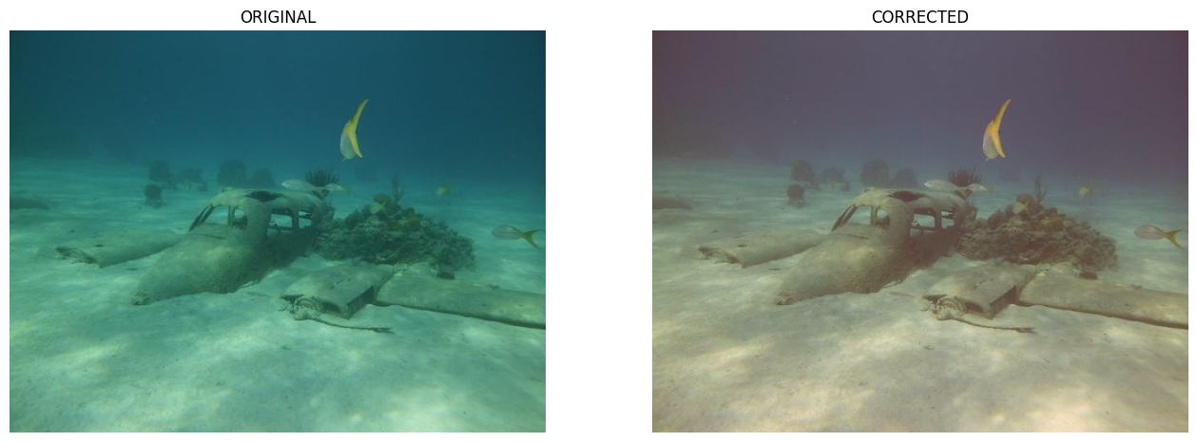
Results After Adaptive Colour Correction

Slide 11
Stationary Wavelet Transform
Wavelet transform , due to its excellent ability in multi-scale analysis and preserving image details , has become an effective tool to deal with the underwater image challenges.
We use stationary wavelet transform(SWT) rather than discrete wavelet transform(DWT) , because stationary wavelet has translation invariance and produces a stable response to small translations of the image.
We choose the simplest member of Daubechies wavelets, the db1 (Haar) wavelet to make the objects and structures in underwater images more clearly recognizable, and further enhance the overall visibility and recognition of the images.

Slide 12
Stationary Wavelet Transform
To find the stationary wavelet transform of the colour corrected image , we use to swt2 function of the python pywt library.
Coeff = pywt.swt2(channel , ‘haar’ , level = 1)
‘haar’ -> the wavelet being used
Level = 1 -> the level of wavelet decomposition
Since , most of the underwater distortions are present in low frequency region , we extract the low frequency information from the wavelet transform
LL = Coeff[0][0]

Slide 13
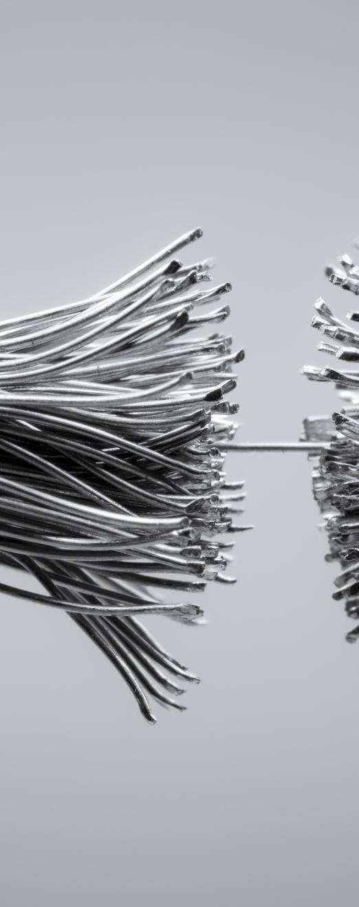
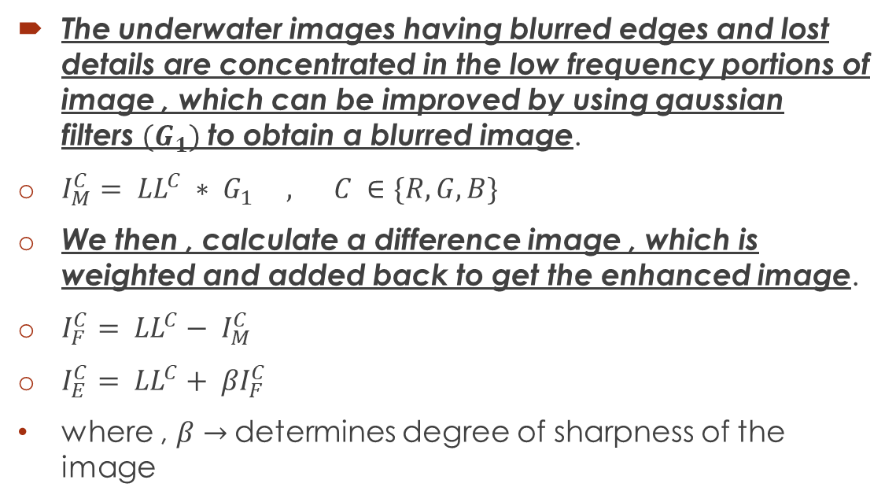
Stationary Wavelet Transform
The underwater images having blurred edges and lost details are concentrated in the low frequency portions of image , which can be improved by using gaussian filters${ (G}_{1})$ to obtain a blurred image.
$I_{M}^{C}= {LL}^{C} ∗ G_{1} , C ∈\{R,G,B\}$
We then , calculate a difference image , which is weighted and added back to get the enhanced image.
$I_{F}^{C}= {LL}^{C}− I_{M}^{C}$
$I_{E}^{C}= {LL}^{C}+ {βI}_{F}^{C}$
where , $β→$determines degree of sharpness of the image

Slide 14
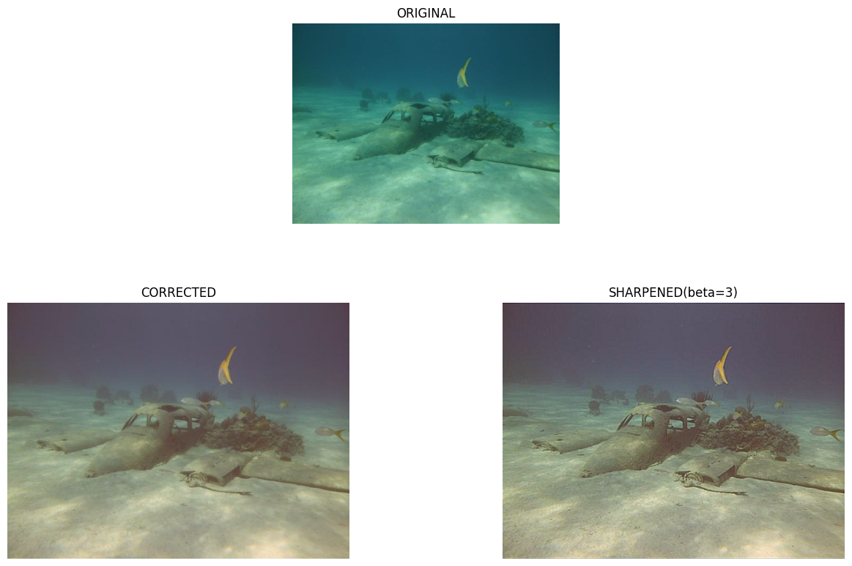
Results After Stationary Wavelet Details Enhancement

Slide 15
RGB channels recombination and histogram equalization
Finally , we recombine the RGB channels using the cv2 library of python:
merged_image = cv2.merge([blue_channel, green_channel, red_channel])
After applying color correction and details enhancement , we finally work on different contrast improvement methods , namely regular histogram equalization and contrast limited adaptive histogram equalization(CLAHE).

Slide 16
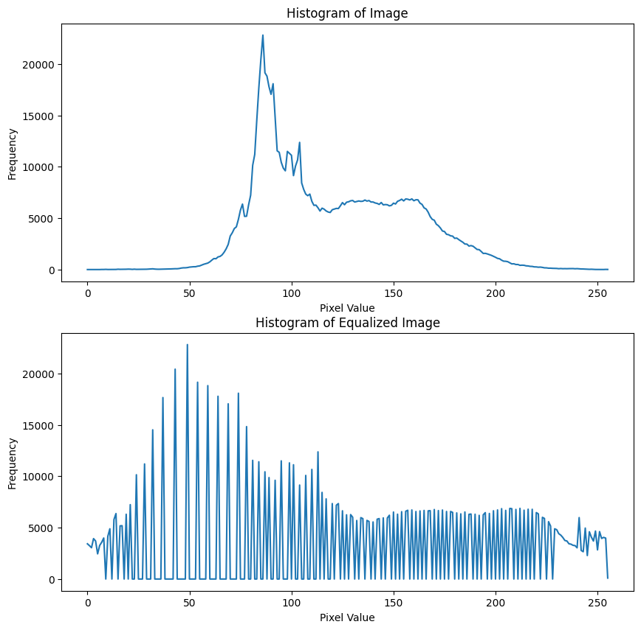
Histogram Equalization
Histogram equalization is a technique used in image processing to improve the contrast of an image by effectively spreading out the intensity values in the histogram.
It redistributes the pixel intensity values so that they cover the entire range of intensities available in the image, resulting in a more evenly distributed histogram and enhancing the overall contrast.

Slide 17
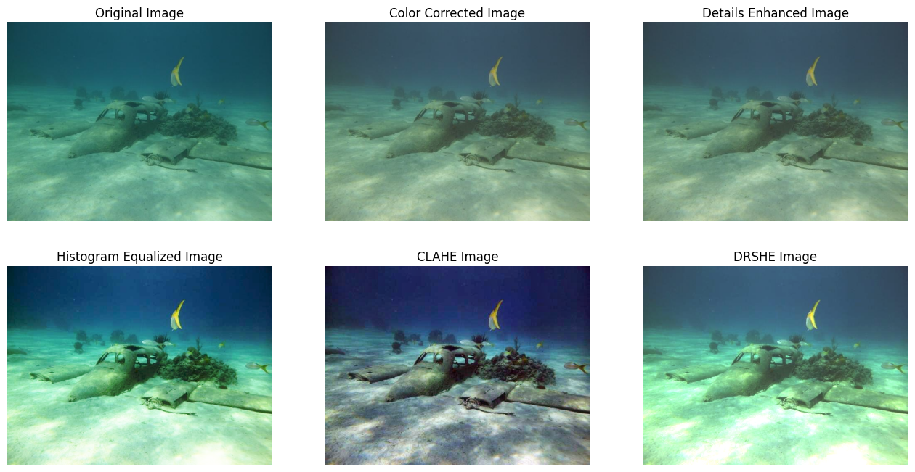
HISTOGRAM EQUALIZATION
This is the image obtained after applying regular histogram equalization to the previously obtained sharpened image.
This method involves global histogram equalization. We next move to local histogram equalization methods.

Slide 18
Contrast Limited Adaptive Histogram Equalization [CLAHE]
CLAHE stands for Contrast Limited Adaptive Histogram Equalization. It is an extension of the histogram equalization technique that addresses some of its limitations, particularly in preserving local contrast while enhancing global contrast.
CLAHE divides the image into small tiles or regions and performs histogram equalization separately on each tile. This ensures that the contrast enhancement is applied locally, preserving the local details and preventing over-amplification of noise.
Additionally, CLAHE includes a contrast limit parameter to prevent excessive amplification of the contrast in regions with a high local contrast. If the contrast after histogram equalization exceeds the specified limit, the pixel values are redistributed to keep the contrast within the defined range.

Slide 19
Contrast Limited Adaptive Histogram Equalization [CLAHE]
Divide the image into non-overlapping tiles
Apply histogram equalization independently to each tile.
Clip the pixel values in each tile to the specified contrast limit.
Interpolate the histogram-equalized tiles to obtain the final enhanced image.

Slide 20
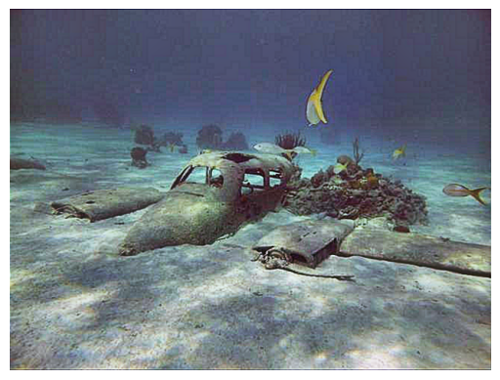
Contrast Limited Adaptive Histogram Equalization [CLAHE]

Slide 21
Dynamic Range Separate Histogram Equalization(DRSHE)
DRSHE separates the dynamic range of histogram into k parts and resizes the grayscale range based on its area ratio.
Then intensities of histogram are uniformly redistributed in resized grayscale range.
DRSHE uses Weighted Average of Absolute color Difference (WAAD) to emphasize the edge of original image and moderate the histogram variation effectively

Slide 22
Dynamic Range Separate Histogram Equalization(DRSHE)
Apply WAAD filter to the image
Calculate the dynamic range of the histogram of image
Divide the dynamic range into k subparts
Calculate the area ratio for each sub-histograms
Resize the grayscale range based on the area ratio
The intensities of histogram are uniformly redistributed in the resized grayscale range.
Gamma correction was applied to improve white balance.

Slide 24
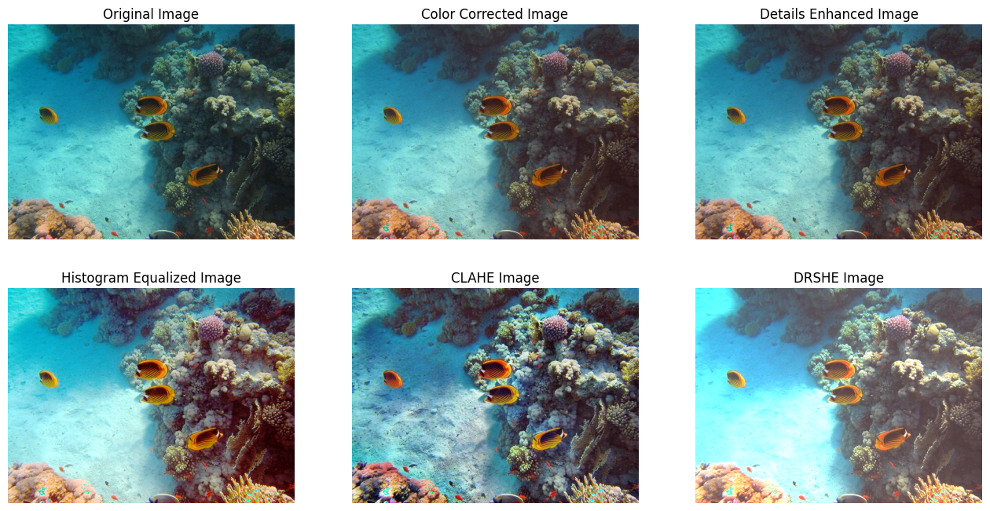

Slide 25
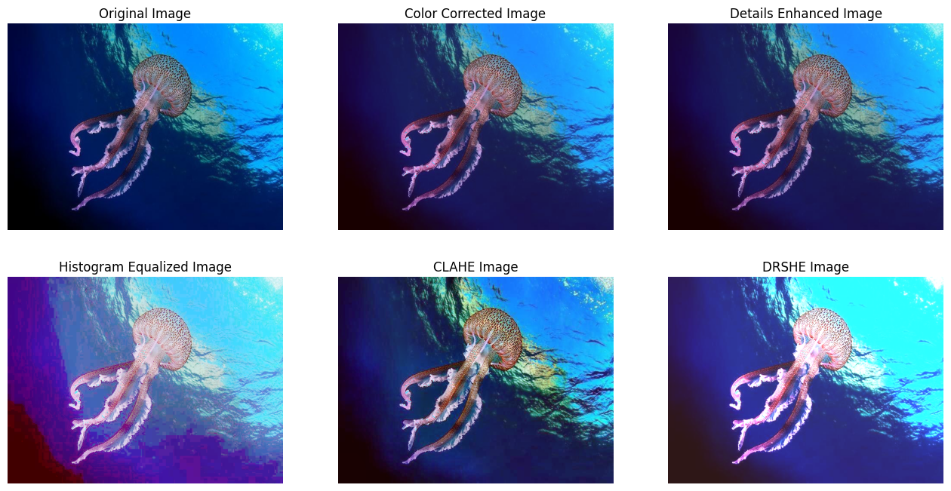

Slide 26
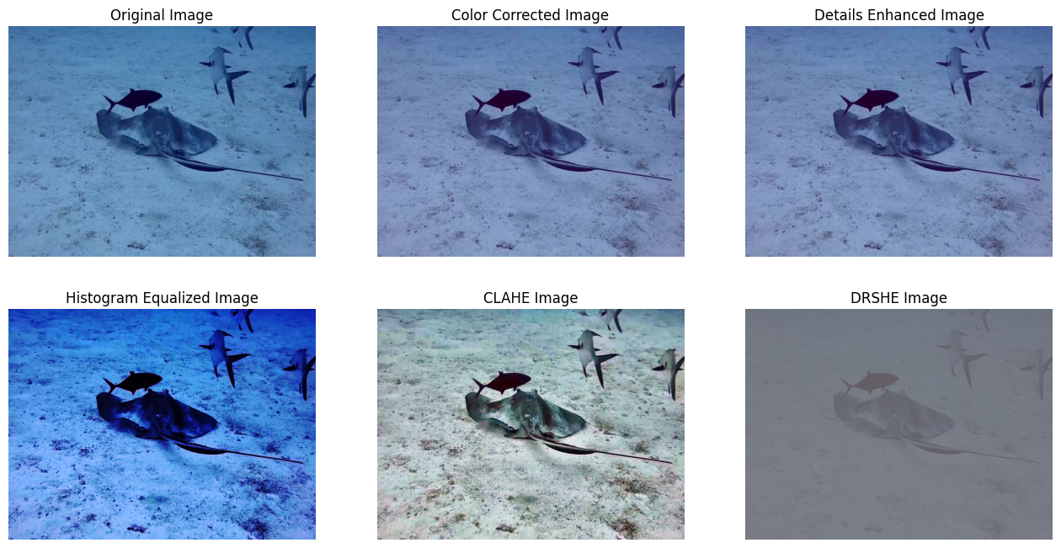

Slide 27
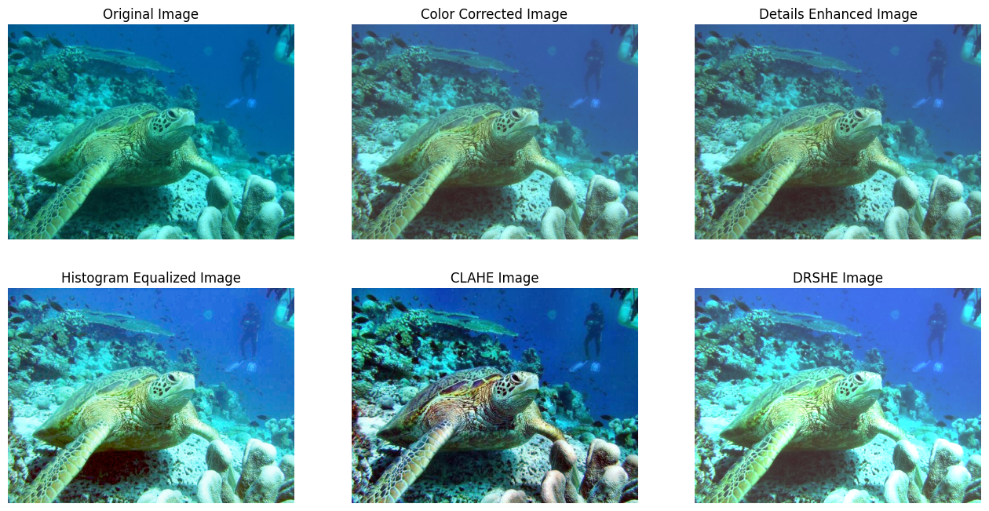

Slide 28
State-of-the-art methods
We compared the results obtained by us with some of the existing state-of-the-art methods in the underwater image enhancement domain.
These methods include conventional methods like:
Underwater Dark Channel Prior (UDCP)
Generation of Dark Channel Prior (GDCP)
Minimal Color Loss and Locally Adaptive Contrast Enhancement (MLLE)
Weighted Wavelet Visual Perception Fusion(WWPF)

Slide 29
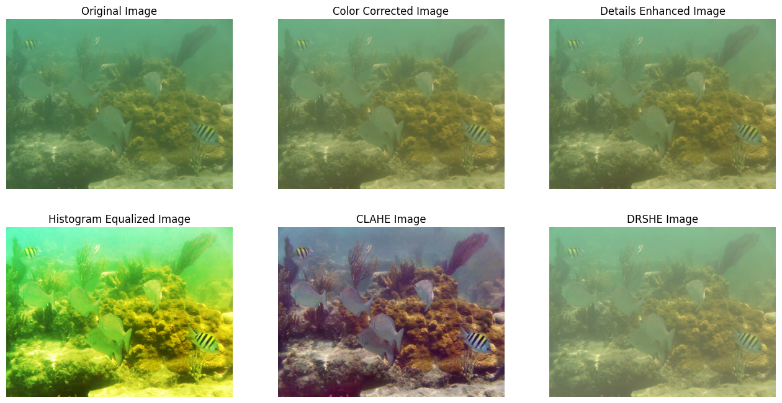
State-of-the-art methods

Slide 30
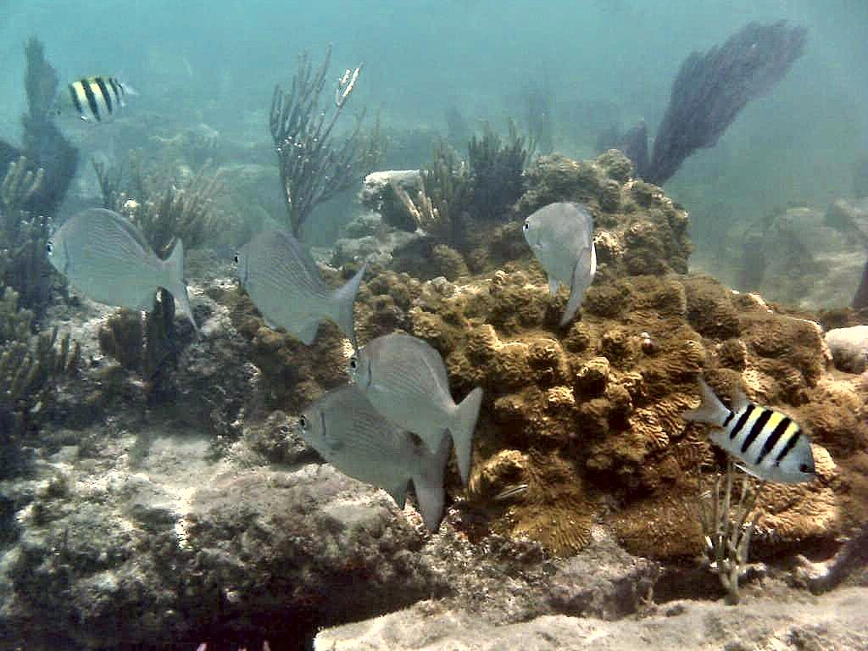
State-of-the-art methods(MLLE)

Slide 31
Conclusion
For image enhancement , we followed the following three major steps :-
Adaptive Color Correction(to improve the quality of red channel with respect to blue and green channels)
Details Enhancement(to sharpen the image using first level wavelet transform decomposition)
Contrast Enhancement(to improve the contrast of the image)
We also obtained the results of different contrast enhancement methods like Histogram Equalization , Contrast Limited Adaptive Histogram Equalization(CLAHE) and Dynamic Range Separate Histogram Equalization(DRSHE) and compared them with the existing state-of-the-art method - Minimal Color Loss and Locally Adaptive Contrast Enhancement (MLLE)

